Slide 1
OKLAHOMA MEDICAL/HEALTH RESPONSE TO A NEW MADRID EARTHQUAKE
Michael Murphy, EMT-P, M.S.
MMRS Director
Emergency Medical Services Authority
April 26, 2012

Slide 2
New Madrid Impact States

Slide 3
Objectives
Understand the complexity involved when formulating plans or a response to an incident
Understand key components of a successful response—and forces aligned to thwart
Understand the dual nature of Oklahoma’s response role
Understand the unique resources that may be offered by Oklahoma.

Slide 4
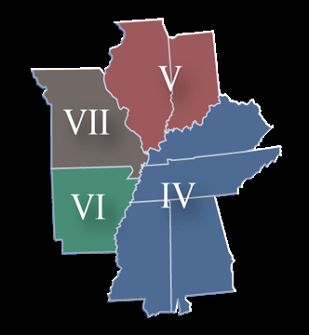
Planning: Not that Simple
Potentially Catastrophic Event:
Sudden-24/7/365
On-going (aftershocks)
Huge Geographic Area Affected
Potentially Affect all Aspects of Life
Infrastructure Damage Dictates Response
Planning “Assumptions”

Slide 5
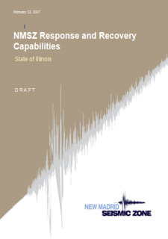
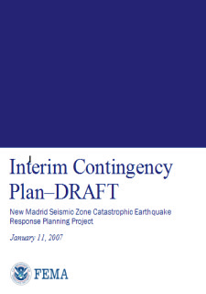
But Quite a Bit Done…
Active planning and research for decades:
FEMA
Corps of Engineers
Federal Agencies
Academia
State Governments
Local Governments

Slide 6
Focus on Mitigation
Mitigation: Steps taken to eliminate risk or reduce the consequences of an incident
Drills/Education
Construction Codes
Retro-fitting
Research

Slide 7
RULE #1: Impact or Not? WE Might Need Help
If Oklahoma suffers any damage from the earthquake, the state will be considered an impact state and NOT a support state
Resources from impact state are kept to assist local response

Slide 8
RULE #2 No Self-Dispatch
Oklahoma resources will not “automatically” respond to any damage area (not officially).
Self-dispatched units can create a situation where needed resources aren’t requested. (Joplin)

Slide 9
RULE #3 It Will Need to Take Time and Restraint
TOO MUCH TIME….
Need to Assess and come up with a game plan.
Patience, Situational Awareness, and Intelligent Resource Application will win the day

Slide 10
RULE #4 Restraint Won’t Happen
“DO Something….”
Unfortunately, several forces will come into play to destroy this process.
Sense of urgency/crisis
Uncontrolled response
Media
Public Safety
Politics

Slide 11
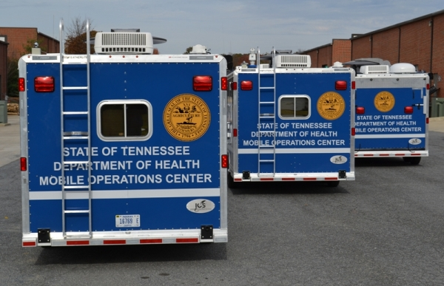
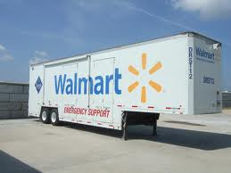
Rule #5 Locals Have Stuff—Lots of Stuff
Impact States have been aware of risk for sometime.
Equipment Caches and specialized equipment exists in region.
Caches located in-state but out of impact area.

Slide 12
Rule #6 There are Others Out There……
41 other states and the federal government willing and able to provide support
EMAC process used for state-to-state sharing of resources—slow
Oklahoma has the advantage/disadvantage of being close

Slide 13
EMAC
Emergency Management Assistance Compact
Means for States to obtain resources from other States.
Methodical and Slow (see Rule #3)—contract between two states and outlines use, conditions, and return of resources.

Slide 14
EMAC
Emergency Management Assistance Compact
Means for States to obtain resources from other States.
Methodical and Slow (see Rule #3)—contract between two states and outlines use, conditions, and return of resources.
Tends to be too slow on occasion (see Rule #4)—assets used by other means
Bidding Process for EMAC—can be frustrating

Slide 15
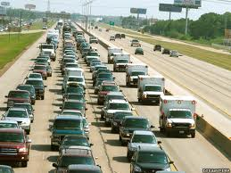
Rule #7 May be Better to Receive than to Give
Real possibility of a mass migration of both evacuees and patients
Infrastructure Disaster Over There……..
Humanitarian Disaster Here……

Slide 16
So….What is Oklahoma’s Medical/Health Plan?
Assess Impact to State
Situational Awareness to and from the Medical/Health System
Resource Assessment (on-going)
Capacity Assessment (on-going)
Solid Communication Lines with Feds and Impacted States
Provide/Request Resources via EMAC or Stafford Act

Slide 17
So….What is Oklahoma’s Medical/Health Plan?
In Other Words: “IT DEPENDS”

Slide 18
So….What is Oklahoma’s Medical/Health Plan?
In Other Words: “IT DEPENDS”
Immediate Impact to the State of Oklahoma..Is there damage?

Slide 19
So….What is Oklahoma’s Medical/Health Plan?
In Other Words: “IT DEPENDS”
Immediate Impact to the State of Oklahoma..Is there damage?
Potential Impact from Reception of Evacuees and Patients—How many are coming?

Slide 20
So….What is Oklahoma’s Medical/Health Plan?
In Other Words: “IT DEPENDS”
Immediate Impact to the State of Oklahoma..Is there damage?
Potential Impact from Reception of Evacuees and Patients—How many are coming?
Resource Availability

Slide 21
So….What is Oklahoma’s Medical/Health Plan?
In Other Words: “IT DEPENDS”
Immediate Impact to the State of Oklahoma..Is there damage?
Potential Impact from Reception of Evacuees and Patients—How many are coming?
Resource Availability
Requests for Resources Via EMAC and/or Federal Government

Slide 22
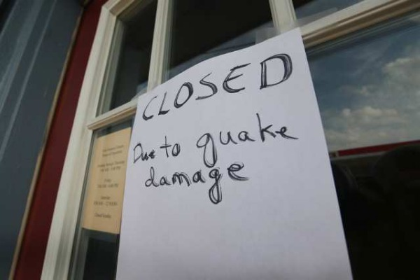
So..If We Can Help--How?
Air Assets
Experienced Personnel
Intact Infrastructure/Money
Intact Medical System
Communication and Coordination System
Response Teams
Hard Assets: Regional Response System

Slide 23
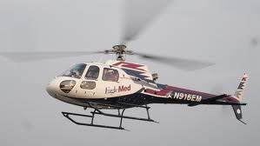
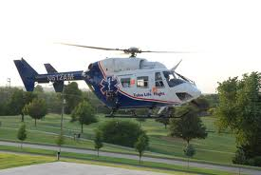
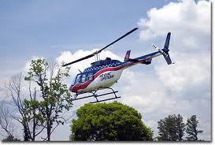
Air Assets
Observation/Assessment
Rescue
Patient Treatment
Patient Movement

Slide 24
Experienced Personnel
Oklahoma “enjoys” a rather large cadre of personnel that have experienced the rather challenging process of managing a disaster….
Personnel can be sent to assist an impact state or, just as importantly, stay in Oklahoma to manage an effective support role.
Oklahoma also has a group of medical and public health professionals that have deployed to assist other areas in crisis in the past.

Slide 25
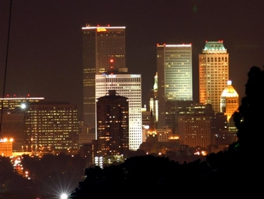
Intact Infrastructure/Money
Oklahoma will likely have an intact infrastructure—something hard to find to the east of the state.
Oklahomans have traditionally been very generous with donations to support agencies

Slide 26
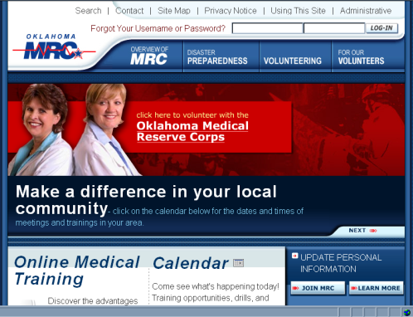
Intact Medical System
Oklahoma will likely also have an intact medical system that may become heavily utilized. Specialty services will be available to assist referred patients.
OKC is an NDMS City with 200-250 NDMS beds.
OKMRC with 3000 members

Slide 27
Communication and Coordination Systems (RMRS)
The Regional Medical Response System (RMRS)
Medical Emergency Response Centers (MERC)
Situation Room-OSDH
MACC

Slide 28
Hard Assets: OSDH/RMRS
Western Shelter System
Build 200 bed field hospital
Generators
70kw on trailer
Water Purification
1 large
2 small
Mass Fatality
MERC System
(1) Semi-Trailer
(2) Trailers- 28 bodies

Slide 29
Hard Assets: Regional Response System (OKOHS)
SUSAR
CBRNE Response
Mass Decontamination
Technical Rescue Units
Mass Casualty Trailers
Technical Rescue Trailers
Agricultural Response Trailers
Command Trailers
REMSS Large Trailers
REMSS Medium and Bantam Trailers

Slide 30
Hard Assets: Regional Response System (OKOHS)
State Urban Search and Rescue (SUSAR)
2 units (OKC/Tulsa)
Identical to FEMA USAR
3 quad 4x4 trucks 1 ton
Bobcat
Trailer

Slide 31
Hard Assets: Regional Response System (OKOHS)
(13) Intermediate CBRNE Trailers:
Command Center
Haz-Mat Mitigation
Light Tower
Generators
Satellite Commo

Slide 32
Hard Assets: Regional Response System (OKOHS)
(2) Mass Decontamination Units
Decon Showers/Hot Water
Rehab Support
Medical Support
Staging Area Support

Slide 33
Hard Assets: Regional Response System (OKOHS)
(24) Small Decon Units
Shelter/Shower Tent
Generator

Slide 34
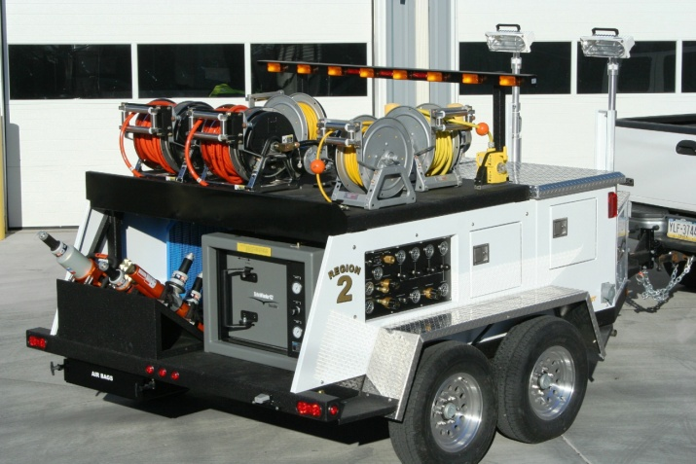
Hard Assets: Regional Response System (OKOHS)
(10) Technical Rescue Units
(13) Small Rescue Units
Generators
Cascade System
Extrication Tools
Light Towers

Slide 35
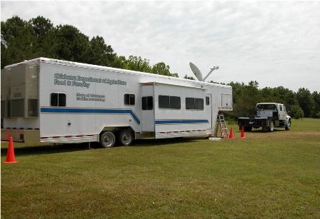
Hard Assets: Regional Response System (OKOHS)
(8) Agricultural Response Units
(1) Mobile Agricultural Laboratory
Clean animals and investigate animal disease outbreak
State Dept. of Agriculture

Slide 36
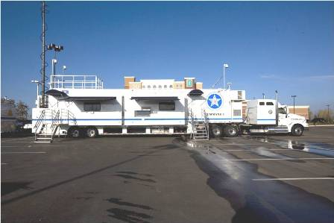
Hard Assets: Regional Response System (OKOHS)
(2)Command Units
Command One
Full Command Post
Radio Bridging Equipment
Internet
Command Two
4X4 Chassis
Radio Bridging
Area Internet

Slide 37
Hard Assets: Regional Response System (OKOHS)
Regional Emergency Medical Service System (REMSS)
(2) Large Trailers
200 patients
Oxygen generation
Oxygen cascade
Lights/Generator
Command Post
Satellite and Internet

Slide 38
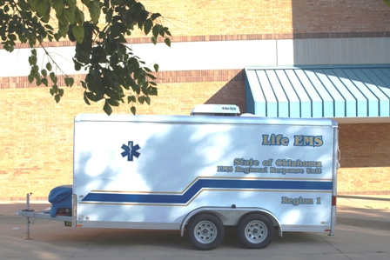
Hard Assets: Regional Response System (OKOHS)
Regional Emergency Medical Service System (REMSS)
(14) Medium
75-100 Patients
Generator/Temp Controlled
72 hour Ops
(15) Bantam
25 patients
Pulled by any vehicle

Slide 39
How it May Play Out…
Rule #1: Oklahoma Likely Not Affected
Rule #5: Impact States Start with Significant Response along with Federal Assets
Rule #2: Some Self-Dispatch—later regretted
Rule # 3: Oklahoma begins slow and organized assessment and response—slow by design, but too slow and selective for people at first…
Rule #4: Oklahomans Go to Help—any way they can
Rule #7: Refugees/Patients Stream into Oklahoma
Rule #6: Nation sends overwhelming response

Slide 40
Questions
Michael Murphy
MMRS Director
Emergency Medical Services Authority
1111 Classen Drive
Oklahoma City, Oklahoma 73103
405-297-7059
murphym@emsa.net

